Slide 1



After data collection
Planning the next steps
Dr Eilidh Cage

Slide 2

Analysing data
What kind of data did you have?
  Can you report percentages? Means?
  More advanced statistics?
  Did you ask any open questions?

Slide 3
Reporting data
What’s the best way to show your data?
Numbers written in text?
Our research found that 40% of the participants were very much looking forward to university
Pie chart?
Scatterplot?

Slide 4
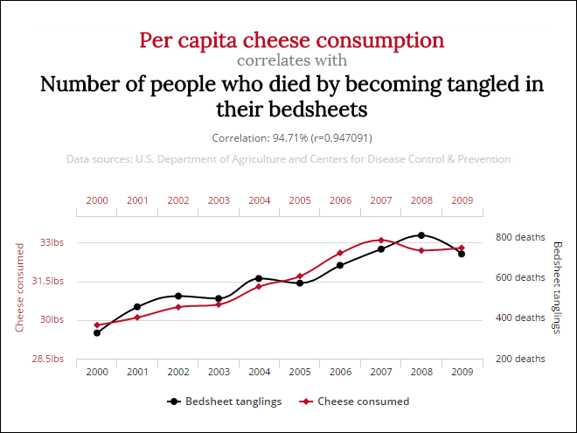
Drawing conclusions
Stick to the facts!
  Don’t over-exaggerate your findings
Correlation does not = causation
Be honest about the limitations of your research

Slide 5


How to report to your school
Create an executive summary
Create a PowerPoint presentation

Slide 6
Any questions?

